Slide 1

Session 04
C# Programming Constructs

Slide 2
Objectives
Explain selection constructs
Describe loop constructs
Explain jump statements in C#

Slide 3
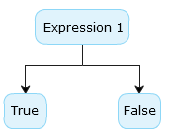
Selection Constructs
C# supports the following decision-making constructs:
if…else
if…else…if
Nested if
switch…case

Slide 4
The if Statement 1-3
The if statement allows you to execute a block of statements after evaluating the specified logical condition.
The if statement starts with the if keyword and is followed by the condition.
If the condition evaluates to true, the block of statements following the if statement is executed.
If the condition evaluates to false, the block of statements following the if statement is ignored and the statement after the block is executed.
The following is the syntax for the if statement:
where,
condition: Is the boolean expression.
statements: Are set of executable instructions executed when the boolean expression returns true.
Syntax
if (condition)
{
// one or more statements;
}

Slide 5
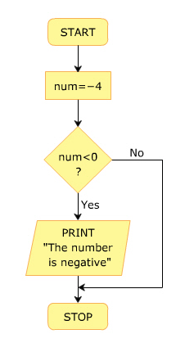
The if Statement 2-3
The following figure displays an example of the if construct:

Slide 6
The if Statement 3-3
The following code displays whether the number is negative using the if statement:
Snippet
int num = -4;
if (num < 0)
{
Console.WriteLine(“The number is negative”);
}
In the code:
num is declared as an integer variable and is initialized to value -4.
The if statement is executed and the value of num is checked to see if it is less than 0.
The condition evaluates to true and the output “The number is negative” is displayed in the console window.
The number is negative.
Output

Slide 7
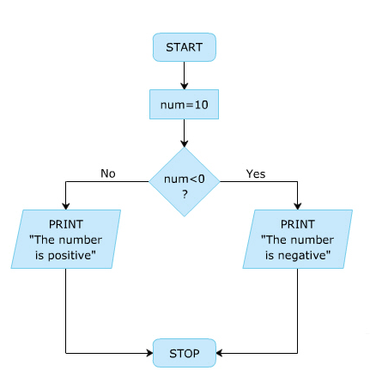
The if…else Construct 1-2
In some situations, it is required to define an action for a false condition by using an if...else construct.
The if...else construct starts with the if block followed by an else block and the else block starts with the else keyword followed by a block of statements.
If the condition specified in the if statement evaluates to false, the statements in the else block are executed.
The following is the syntax for the if...else statement:
Syntax
if (condition)
{
// one or more statements;
}
else
{
//one or more statements;
}

Slide 8
The if…else Construct 2-2
The following code displays whether a number is positive or negative using the if...else construct:
In the code:
num is declared as an integer variable and is initialized to value 10.
The if statement is executed and the value of num is checked to see if it is less than 0.
The condition evaluates to false and the program control is passed to the else block and the output “The number is positive” is displayed in the console window.
The number is positive.
Snippet
int num = 10;
if (num < 0)
{
Console.WriteLine(“The number is negative”);
}
else
{
Console.WriteLine(“The number is positive”);
}
Output

Slide 9
The if…else…if Construct 1-3
The if…else…if construct allows you to check multiple conditions to execute a different block of code for each condition.
It is also referred to as if-else–if ladder.
The construct starts with the if statement followed by multiple else if statements followed by an optional else block.
The conditions specified in the if…else…if construct are evaluated sequentially.
The execution starts from the if statement. If a condition evaluates to false, the condition specified in the following else…if statement is evaluated.
The syntax for the if…else…if construct is as follows:
Syntax
{
// one or more statements;
}
else if (condition)
{
// one or more statements;
}
else
{
// one or more statements;
}

Slide 10
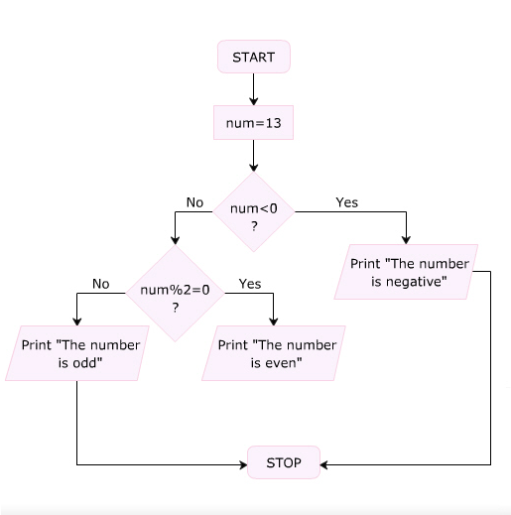
The if…else…if Construct 2-3
The following figure displays an example of the if…else…if construct:

Slide 11
The if…else…if Construct 3-3
The following code displays whether a number is negative, even, or odd using the if…else…if construct:
int num = 13;
if (num < 0)
{
Console.WriteLine(“The number is negative”);
}
else if ((num % 2) == 0)
{
Console.WriteLine(“The number is even”);
}
Snippet
In the code:
num is declared as an integer variable and is initialized to value 13.
The if statement is executed and the value of num is checked to see if it is less than 0.
The condition evaluates to false and the program control is passed to the else if block.
The value of num is divided by 2 and the remainder is checked to see if it is 0. This condition evaluates to false and the control passes to the else block.
Finally, the output “The number is odd” is displayed in the console window.

Slide 12
Nested if Construct 1-3
Following are the features of the nested if construct:
The nested if construct consists of multiple if statements.
The nested if construct starts with the if statement, which is called the outer if statement, and contains multiple if statements, which are called inner if statements.
In the nested if construct, the outer if condition controls the execution of the inner if statements. The compiler executes the inner if statements only if the condition in the outer if statement is true.
In addition, each inner if statement is executed only if the condition in its previous inner if statement is true.

Slide 13
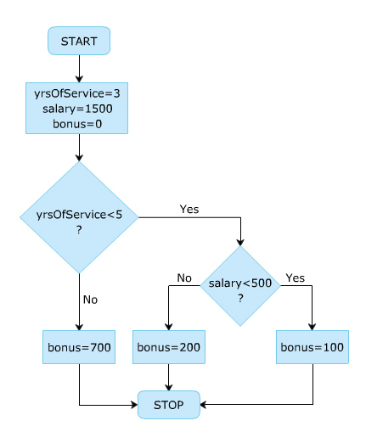
Nested if Construct 2-3
The following is the syntax for the nested if construct:
The following figure displays an example of the nested if construct:
Syntax
if (condition)
{
// one or more statements;
if (condition)
{
// one or more statements;
if (condition)
{
// one or more statements;
}
}
}

Slide 14
Nested if Construct 3-3
The following figure displays the bonus amount using the nested if construct:
In the code:
yrsOfService and bonus are declared as integer variables and initialized to values 3 and 0 respectively.
In addition, salary is declared as a double and is initialized to value 1500.
The first if statement is executed and the value of yrsOfService is checked to see if it is less than 5.
This condition is found to be true. Next, the value of salary is checked to see if it is less than 500.
This condition is found to be false. Hence, the control passes to the else block of the inner if statement. Finally, the bonus amount is displayed as 200.
Bonus amount: 200
Snippet
int yrsOfService = 3;
double salary = 1500;
int bonus = 0;
if (yrsOfService < 5)
{
if (salary < 500)
{
bonus = 100;
}
else
{
bonus = 200;
}
}
else
{
bonus = 700;
}
Console.WriteLine(“Bonus amount: “ + bonus);
Output

Slide 15
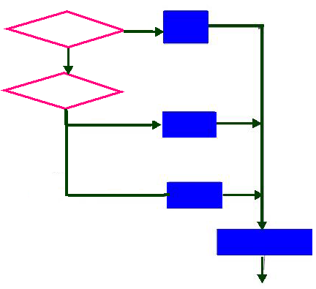
switch…case Construct 1-5
A program is difficult to comprehend when there are too many if statements representing multiple selection constructs.
To avoid using multiple if statements, in certain cases, the switch…case approach can be used as an alternative.
The switch…case statement is used when a variable needs to be compared against different values.
The following figure depicts the switch…case as a flow chart.

Slide 16
switch…case Construct 2-5
The switch…case construct has the following components:
switch: The switch keyword is followed by an integer expression enclosed in parentheses. The expression must be of type int, char, byte, or short. The switch statement executes the case corresponding to the value of the expression.
case: The case keyword is followed by a unique integer constant and a colon. Thus, the case statement cannot contain a variable. The block following a particular case statement is executed when the switch expression and the case value match. Each case block must end with the break keyword that passes the control out of the switch construct.

Slide 17
switch…case Construct 3-5
default: If no case value matches the switch expression value, the program control is transferred to the default block. This is the equivalent of the else block of the if...else...if construct.
break: The break statement is optional and is used inside the switch…case statement to terminate the execution of the statement sequence. The control is transferred to the statement after the end of switch. If there is no break, execution flows sequentially into the next case statement. Sometimes, multiple case statements can be present without break statements between them.

Slide 18
switch…case Construct 4-5
The following code displays the day of the week using the switch...case construct:
Snippet
int day = 5;
switch (day)
{
case 1:
Console.WriteLine(“Sunday”);
break;
case 2:
Console.WriteLine(“Monday”);
break;
case 3:
Console.WriteLine(“Tuesday”);
break;
case 4:
Console.WriteLine(“Wednesday”);
break;
case 5:
Console.WriteLine(“Thursday”);
break;
case 6:
Console.WriteLine(“Friday”);
break;
case 7:
Console.WriteLine(“Saturday”);
break;
default:
Console.WriteLine(“Enter a number between 1 to 7”);
break;
}

Slide 19
switch…case Construct 5-5
In the code:
day is declared as an integer variable and is initialized to value 5.
The block of code following the case 5 statement is executed because the value of day is 5 and the day is displayed as Thursday.
When the break statement is encountered, the control passes out of the switch…case construct.
Thursday
Output

Slide 20
Nested switch…case Construct 1-4
C# allows the switch…case construct to be nested. That is, a case block of a switch…case construct can contain another switch…case construct.
Also, the case constants of the inner switch…case construct can have values that are identical to the case constants of the outer construct.
The following code demonstrates the use of nested switch:
Snippet
namespace Samsung
using System;
class Math
{
static void Main(string[] args)
{
int numOne;
int numTwo;
int result = 0;
Console.WriteLine("(1) Addition");
Console.WriteLine("(2) Subtraction");
Console.WriteLine("(3) Multiplication");
Console.WriteLine("(4) Division");
int input = Convert.ToInt32(Console.ReadLine());
Console.WriteLine("Enter value one");
numOne = Convert.ToInt32(Console.ReadLine());

Slide 21
Nested switch…case Construct 2-4
Console.WriteLine("Enter value two");
numTwo = Convert.ToInt32(Console.ReadLine());
switch (input)
{
case 1:
result = numOne + numTwo;
break;
case 2:
result = numOne - numTwo;
break;
case 3:
result = numOne * numTwo;
break;
switch (input)
{
case 1:
result = numOne + numTwo;
break;
case 2:
result = numOne - numTwo;
break;
case 3:
result = numOne * numTwo;
break;
case 4:
Console.WriteLine("Do you want to calculate
the quotient or remainder?");
Console.WriteLine("(1) Quotient");
Console.WriteLine("(2) Remainder");
int choice = Convert.ToInt32
(Console.ReadLine());

Slide 22
Nested switch…case Construct 3-4
switch (choice)
{
case 1:
result = numOne / numTwo;
break;
case 2:
result = numOne % numTwo;
break;
default:
Console.WriteLine("Incorrect Choice");
break;
}
break;
default:
Console.WriteLine("Incorrect Choice");
break;
}
Console.WriteLine("Result: " + result);
}
}

Slide 23
Nested switch…case Construct 4-4
In the code:
The user is asked to choose the desired arithmetical operation. The user then enters the numbers on which the operation is to be performed.
Using the switch…case construct, based on the input from the user, the appropriate operation is performed.
The case block for the division option uses an inner switch…case construct to either calculate the quotient or the remainder of the division as per the choice selected by the user.
The following figure demonstrates the nested switch:

Slide 24
No-Fall-Through Rule 1-3
Following are the ‘no-fall-through’ rules:
Although C# does not permit the statement sequence of one case block to fall through to the next, it does allow empty case blocks (case blocks without any statements) to fall through.
In C#, the flow of execution from one case statement is not allowed to continue to the next case statement and is referred to as the ‘no-fall-through’ rule of C#.
Thus, the list of statements inside a case block generally ends with a break or a goto statement, which causes the control of the program to exit the switch…case construct and go to the statement following the construct.
The last case block (or the default block) also needs to have a statement like break or goto to explicitly take the control outside the switch…case construct.
C# introduced the no fall-through rule to allow the compiler to rearrange the order of the case blocks for performance optimization.

Slide 25
No-Fall-Through Rule 2-3
A multiple case statement can be made to execute the same code sequence, as shown in the following code:
Snippet
namespace Samsung
using System;
class Months
{
static void Main(string[] args)
{
string input;
Console.WriteLine("Enter the month");
input = Console.ReadLine().ToUpper();
switch (input)
{
case "JANUARY":
case "MARCH":
case "MAY":
case "JULY":
case "AUGUST":
case "OCTOBER":
case "DECEMBER":
Console.WriteLine ("This month has 31 days");
break;
case "APRIL":
case "JUNE":
case "SEPTEMBER":

Slide 26
No-Fall-Through Rule 3-3
In the code:
The switch…case construct is used to display the number of days in a particular month.
Here, all months having 31 days have been stacked together to execute the same statement.
Similarly, all months having 30 days have been stacked together to execute the same statement.
Here, the no-fall-through rule is not violated as the stacked case statements execute the same code.
By stacking the case statements, unnecessary repetition of code is avoided.
The figure shows the output of multiple case statements:
case "NOVEMBER":
Console.WriteLine ("This month has 30 days");
break;
case "FEBRUARY":
Console.WriteLine("This month has 28 days in
a non-leap year and 29 days in a leap year");
break;
default:
Console.WriteLine ("Incorrect choice");
break;
}
}
}

Slide 27
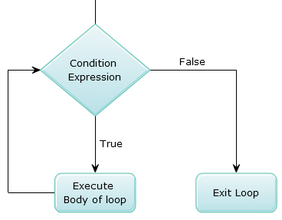
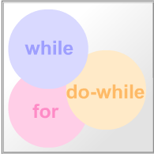
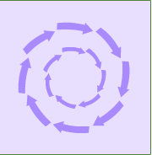
Loop Constructs
Loops allow you to execute a single statement or a block of statements repetitively.
The most common uses of loops include displaying a series of numbers and taking repetitive input.
In software programming, a loop construct contains a condition that helps the compiler identify the number of times a specific block will be executed.
If the condition is not specified, the loop continues infinitely and is termed as an infinite loop.
The loop constructs are also referred to as iteration statements.
C# supports four types of loop constructs such as:
The while loop
The do..while loop
The for loop
The foreach loop

Slide 28
The while Loop 1-3
The while loop is used to execute a block of code repetitively as long as the condition of the loop remains true.
The while loop consists of the while statement, which begins with the while keyword followed by a boolean condition.
If the condition evaluates to true, the block of statements after the while statement is executed.
After each iteration, the control is transferred back to the while statement and the condition is checked again for another round of execution.
When the condition is evaluated to false, the block of statements following the while statement is ignored and the statement appearing after the block is executed by the compiler.
The following is the syntax of the while loop:
where:
condition: Specifies the boolean expression.
Syntax
while (condition)
{
// one or more statements;
}

Slide 29
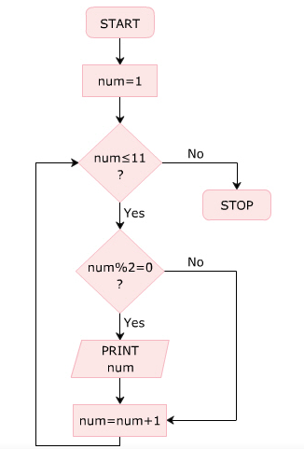
The while Loop 2-3
The following figure depicts an example of a while loop using a flowchart:
The following code displays even numbers from 1 to 10 using the while loop:
Snippet
public int num = 1;
Console.WriteLine(“Even Numbers”);
while (num <= 11)
{
if ((num % 2) == 0)
{
Console.WriteLine(num);
}
num = num + 1;
}

Slide 30
The while Loop 3-3
In the following code:
num is declared as an integer variable and initialized to value 1.
The condition in the while loop is checked, which specifies that the value of num variable should be less than or equal to 11.
If this condition is true, the value of the num variable is divided by 2 and the remainder is checked to see if it is 0.
If the remainder is 0, the value of the variable num is displayed in the console window and the variable num is incremented by 1.
Then, the program control is passed to the while statement to check the condition again.
When the value of num becomes 12, the while loop terminates as the loop condition becomes false.
Even Numbers
2
4
6
8
10
Output

Slide 31
Nested while Loop
A while loop can be created within another while loop to create a nested while loop structure.
The following code demonstrates the use of nested while loops to create a geometric pattern:
In the code:
A pattern of a right-angled triangle is created using the asterisk (*) symbol. This is done using the nested while loop.
using System;
class Pattern
{
static void Main(string[] args)
{
int i = 0;
int j;
while (i <= 5)
{
j = 0;
while (j <= i)
{
Console.Write("*");
j++;
}
Console.WriteLine();
i++;
}
}
}
Snippet

Slide 32
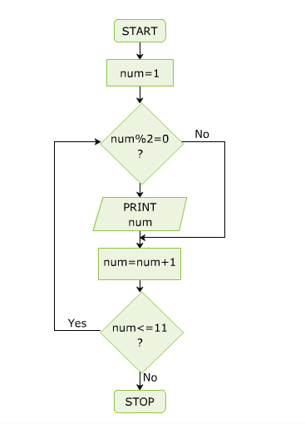
The do-while Loop 1-2
The do-while loop is similar to the while loop; however, it is always executed at least once without the condition being checked.
The loop starts with the do keyword and is followed by a block of executable statements.
The while statement along with the condition appears at the end of this block.
The statements in the do-while loop are executed as long as the specified condition remains true.
When the condition evaluates to false, the block of statements after the do keyword are ignored and the immediate statement after the while statement is executed.
The following is the syntax of the do-while loop:
Syntax
do
{
// one or more statements;
} while (condition);

Slide 33
The do-while Loop 2-2
The following code displays even numbers from 1 to 10 using the do-while loop:
In the code:
num is declared as an integer variable and is initialized to value 1.
In the do block, without checking any condition, the value of num is first divided by 2 and the remainder is checked to see if it is 0.
If the remainder is 0, the value of num is displayed and it is then incremented by 1.
Then, the condition in the while statement is checked to see if the value of num is less than or equal to 11.
If this condition is true, the do-while loop executes again.
When the value of num becomes 12, the do-while loop terminates.
Even Numbers
2
4
6
8
10
int num = 1;
Console.WriteLine(“EvenNumbers”); do
{
if ((num % 2) == 0) {
Console.WriteLine(num);
}
num = num + 1;
} while (num <= 11);
Snippet
Output

Slide 34
The for Loop 1-3
The for statement is similar to the while statement in its function.
The statements within the body of the loop are executed as long as the condition is true.
Here too, the condition is checked before the statements are executed.
The following is the syntax of the for loop:
where,
initialization: Initializes the variable(s) that will be used in the condition.
condition: Comprises the condition that is tested before the statements in the loop are executed.
increment/decrement: Comprises the statement that changes the value of the variable(s) to ensure that the condition specified in the condition section is reached. Typically, increment and decrement operators such as ++, -- and shortcut operators such as += or -= are used in this section. Note that there is no semicolon at the end of the increment/decrement expressions.
Syntax
for (initialization; condition; increment/decrement)
{
// one or more statements;
}

Slide 35
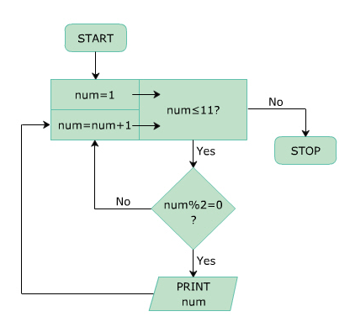
The for Loop 2-3
The working of the for loop can be depicted using the following flowchart:

Slide 36
The for Loop 3-3
The following code displays even numbers from 1 to 10 using the for loop:
In the code:
num is declared as an integer variable and it is initialized to value 1 in the for statement.
The condition specified in the for statement is checked for value of num to be less than or equal to 11.
If this condition is true, value of num is divided by 2 and the remainder is checked to see if it is 0.
If this condition is true, the control is passed to the for statement again.
Here, the value of num is incremented and the condition is checked again.
When the value of num becomes 12, the condition of the for loop becomes false and the loop terminates.
int num;
Console.WriteLine(“Even Numbers”);
for (num = 1; num <= 11; num++) {
if ((num % 2) == 0)
{
Console.WriteLine(num);
}
}
Snippet

Slide 37
Nested for Loops
The nested for loop consists of multiple for statements. When one for loop is enclosed inside another for loop, the loops are said to be nested.
The for loop that encloses the other for loop is referred to as the outer for loop whereas the enclosed for loop is referred to as the inner for loop.
The outer for loop determines the number of times the inner for loop will be invoked.
The following code demonstrates a 2X2 matrix using nested for loops:
In the code:
The rows and columns are declared as integer variables and are initialized to value 2.
In addition, i and j are declared as integer variables in the outer and inner for loops respectively and both are initialized to 0. When the outer for loop is executed, the value of i is checked to see if it is less than 2.
Here, the condition is true; hence, the inner for loop is executed. In this loop, the value of j is checked to see if it is less than 2.
As long as it is less than 2, the product of the values of I and j is displayed in the console window. This inner for loop executes until j becomes greater than or equal to 2, at which time, the control passes to the outer for loop.
int rows = 2;
int columns = 2;
for (int i = 0; i < rows; i++)
{
for (int j = 0; j < columns; j++)
{
Console.Write(“{0} “,i*j);
}
Console.WriteLine();
}
Snippet

Slide 38
The for Loop with Multiple Loop Control Variables
The for loop allows the use of multiple variables to control the loop.
The following code demonstrates the use of the for loop with two variables:
In the code:
The initialization portion as well as the increment/decrement portion of the for loop definition contain two variables, i and j.
These variables are used in the body of the for loop, to display the square of all even numbers, and the cube of all odd numbers between 1 and 10.
The following figure shows the use of the for loop:
using System;
class Numbers
{
static void Main(string[] args)
{
Console.WriteLine("Square \t\tCube");
for (int i = 1, j = 0; i < 11; i++, j++)
{
if ((i % 2) == 0)
{
Console.Write("{0} = {1} \t", i, (i * i));
Console.Write("{0} = {1} \n", j, (j * j * j));
}
}
}
}
Snippet

Slide 39
The for Loop with Missing Portions 1-5
The for loop definition can be divided into three portions, the initialization, the conditional expression, and the increment/decrement portion.
C# allows the creation of the for loop even if one or more portions of the loop definition are omitted.
In fact, the for loop can be created with all the three portions omitted.
The following code demonstrates a for loop that leaves out or omits the increment/decrement portion of the loop definition:
using System;
class Investment
{
static void Main(string[] args)
{
int investment;
int returns;
int expenses;
int profit;
int counter = 0;
for (investment=1000, returns=0; returns<investment;)
{
Console.WriteLine("Enter the monthly expenditure");
expenses = Convert.ToInt32(Console.ReadLine());
Console.WriteLine("Enter the monthly profit");
profit = Convert.ToInt32(Console.ReadLine());
investment += expenses;
returns += profit;
counter++;
}
Console.WriteLine("Number of months to break even: "
+ counter);
}
}
Snippet

Slide 40
The for Loop with Missing Portions 2-5
In the code:
The for loop is used to calculate the number of months it has taken for a business venture to recover its investment and break even.
The expenditure and the profit for every month is accepted from the user and stored in variables expenses and profit respectively.
The total investment is calculated as the initial investment plus the monthly expenses. The total returns are calculated as the sum of the profits for each month.
The conditional expression of the loop terminates the loop once the total returns of the business becomes greater than or equal to the total investment.
The code then prints the total number of months it has taken the business to break even.
The number of months equals the number of iterations of the for loop as each iteration represents a new month.

Slide 41
The for Loop with Missing Portions 3-5
The following code demonstrates a for loop that omits the initialization portion as well as the increment/decrement portion of the loop definition:
In the code:
The initialization of the variables investment and returns has been done prior to the for loop definition. Hence, the loop has been defined with the initialization portion left empty.
If the conditional expression portion of the for loop is omitted, the loop becomes an infinite loop. Such loops can then be terminated using jump statements such as break or goto to exit the loop.
The following code demonstrates the use of an infinite for loop:
int investment = 1000;
int returns = 0;
for (; returns < investment; )
{
// for loop statements
. . .
}
Snippet
using System;
class Summation
{
static void Main(string[] args)
{
char c;
int numOne;
int numTwo;
int result;
for ( ; ; )
Snippet

Slide 42
The for Loop with Missing Portions 4-5
In the code:
An infinite for loop is used to repetitively accept two numbers from the user.
These numbers are added and their result printed on the console.
After each iteration of the loop, the if construct is used to check whether the user wishes to continue or not.
If the answer is Y or y (denoting yes), the loop is executed again, else the loop is exited using the break statement.
{
Console.WriteLine("Enter number one");
numOne = Convert.ToInt32(Console.ReadLine());
Console.WriteLine("Enter number two");
numTwo = Convert.ToInt32(Console.ReadLine());
result = numOne + numTwo;
Console.WriteLine("Result of Addition: " +
result);
Console.WriteLine("Do you wish to continue [Y / N]");
c = Convert.ToChar(Console.ReadLine());
if (c == 'Y' || c == 'y')
{
continue;
}
else
{
break;
}
}
}
}

Slide 43
The for Loop with Missing Portions 5-5
The following figure shows the use of an infinite for loop:

Slide 44
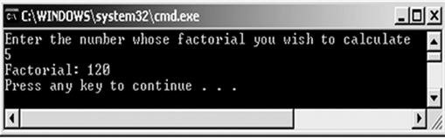
The for Loop without a Body
In C#, a for loop can be created without a body.
Such a loop is created when the operations performed within the body of the loop can be accommodated within the loop definition itself.
The following code demonstrates the use of a for loop without a body:
In the code:
The process of calculating the factorial of a user-given number is done entirely in the for loop definition; the loop has no body.
The following figure shows the for loop without a body:
Snippet
using System;
class Factorial
{
static void Main(string[] args)
{
int fact = 1;
int num, i;
Console.WriteLine("Enter the number whose factorial you
wish to calculate");
num = Convert.ToInt32(Console.ReadLine());
for (i = 1; i <= num; fact *= i++);
Console.WriteLine("Factorial: " + fact);
}
}

Slide 45
Declaring Loop Control Variables in the Loop Definition 1-3
The loop control variables are often created for loops such as the for loop. Once the loop is terminated, there is no further use of these variables. In such cases, these variables can be created within the initialization portion of the for loop definition.
The following is the syntax for declaring the loop control variable within the loop definition:
where,
datatype: Specifies the data type of the elements in the list.
identifier: Is an appropriate name for the collection of elements.
list: Specifies the name of the list.
Syntax
foreach (<datatype><identifier> in <list>)
{
// one or more statements;
}

Slide 46
Declaring Loop Control Variables in the Loop Definition 2-3
The following figure displays the employee names using the foreach loop:
In the code:
The list of employee names is declared in an array of string variables called employeeNames.
In the foreach statement, the data type is declared as string and the identifier is specified as names.
This variable refers to all values from the employeeNames array.
The foreach loop displays names of the employees in the order in which they are stored.
Employee Names
Maria
Wilson
Elton
Garry
Snippet
string[] employeeNames = { “Maria”, “Wilson”, “Elton”, “Garry” };
Console.WriteLine(“Employee Names”);
foreach (string names in employeeNames)
{
Console.WriteLine(“{0} “, names);
}
Output

Slide 47
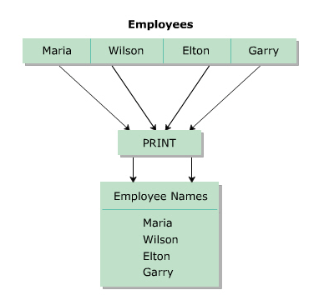
Declaring Loop Control Variables in the Loop Definition 3-3
The following figure depicts the working of the foreach loop:

Slide 48
Jump Statements in C#
Jump statements are used to transfer control from one point in a program to another.
There will be situations where you need to exit out of a loop prematurely and continue with the program.
In such cases, jump statements are used. Jump statement unconditionally transfer control of a program to a different location.
The location to which a jump statement transfers control is called the target of the jump statement.
C# supports four types of jump statements. These are as follows:
break
continue
goto
return

Slide 49
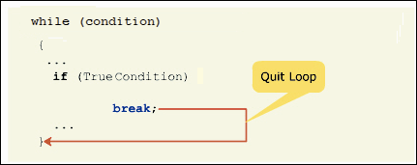
The break Statement 1-2
The break statement is used in the selection and loop constructs.
It is most widely used in the switch...case construct and in the for and while loops.
The break statement is denoted by the break keyword. In the switch...case construct, it is used to terminate the execution of the construct.
In loops, it is used to exit the loop without testing the loop condition.
In this case, the control passes to the next statement following the loop.
The following figure depicts the break statement:

Slide 50
The break Statement 2-2
The following figure displays a prime number using the while loop and the break statement:
In the code:
The numOne and numTwo are declared as integer variables and are initialized to values 17 and 2 respectively.
In the while statement, if the condition is true, the inner if condition is checked. If this condition evaluates to true, the program control passes to the if statement outside the while loop.
If the condition is false, the value of numTwo is incremented and the control passes to the while statement again.
Prime Number
Snippet
int numOne = 17;
int numTwo = 2;
while(numTwo <= numOne-1)
{
if(numOne % numTwo == 0)
{
Console.WriteLine(“Not a Prime Number”);
break;
}
numTwo++;
}
if(numTwo == numOne)
{
Console.WriteLine(“Prime Number”);
}
Output

Slide 51
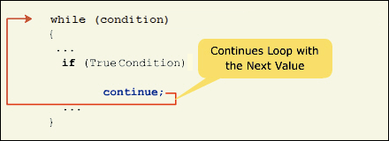
The continue Statement 1-2
The continue statement is most widely used in the loop constructs and is denoted by the continue keyword.
The continue statement is used to end the current iteration of the loop and transfer the program control back to the beginning of the loop. The statements of the loop following the continue statement are ignored in the current iteration.
The following figure displays the working of the continue statement:

Slide 52
The continue Statement 2-2
The following code displays the even numbers in the range of 1 to 10 using the for loop and the continue statement:
In the code:
i is declared as an integer and is initialized to value 1 in the for loop definition.
In the body of the loop, the value of i is divided by 2 and the remainder is checked to see if it is equal to 0.
If the remainder is zero, the value of i is displayed as the value is an even number.
If the remainder is not equal to 0, the continue statement is executed and the program control is transferred to the beginning of the for loop.
Even numbers in the range of 1-10.
2 4 6 8 10
Snippet
Console.WriteLine(“Even numbers in the range of 1-10”);
for (int i=1; i<=10; i++)
{
if (i % 2 != 0)
{
continue;
}
Console.Write(i + “ “);
}
Output

Slide 53
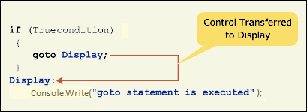
The goto Statement 1-4
The goto statement allows you to directly execute a labeled statement or a labeled block of statements.
A labeled block or a labeled statement starts with a label. A label is an identifier ending with a colon.
A single labeled block can be referred by more than one goto statements.
The goto statement is denoted by the goto keyword.
The following code displays the goto statement:
The following figure displays the output “Hello World” five times using the goto statement:
Snippet
int i = 0;
display:
Console.WriteLine(“Hello World”);
i++;
if (i < 5)
{
goto display;
}

Slide 54
The goto Statement 2-4
In the code:
i is declared as an integer and is initialized to value 0.
The program control transfers to the display label and the message “Hello World” is displayed.
Then, the value of i is incremented by 1 and is checked to see if it is less than 5.
If this condition evaluates to true, the goto statement is executed and the program control is transferred to the display label. If the condition evaluates to false, the program ends.
Hello World
Hello World
Hello World
Hello World
Hello World
Output

Slide 55
The goto Statement 3-4
The following code demonstrates the use of goto statement to break out of a nested loop:
Snippet
using System;
class Factorial
{
static void Main(string[] args)
{
byte num = 0;
while (true)
{
byte fact = 1;
Console.Write("Please enter a number less than or equal to
10: ");
num = Convert.ToByte(Console.ReadLine());
if (num < 0)
{
goto stop;
}
for (byte j = num; j > 0; j--)
{
if (j >10)
{
goto stop;
}
fact *= j;
}
Console.WriteLine("Factorial of {0} is {1}", num, fact);
}
stop:
Console.WriteLine("Exiting the program");
}
}

Slide 56
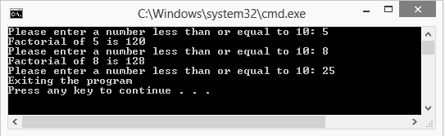
The goto Statement 4-4
The following figure shows the use of goto statement:

Slide 57
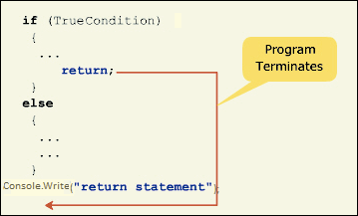
The return Statement 1-3
The return statement is used to return a value of an expression or is used to transfer the control to the method from which the currently executing method was invoked.
The return statement is denoted by the return keyword. The return statement must be the last statement in the method block.
The following figure displays the working of the return statement:

Slide 58
The return Statement 2-3
The following code displays the cube of a number using the return statement:
In the code:
The variable num is declared as an integer and is initialized to value 23.
The Cube()method is invoked by the Console.WriteLine() method.
At this point, the program control passes to the Cube()method, which returns the cube of the specified value. The return statement returns the calculated cube value back to the Console.WriteLine() method, which displays the calculated cube of 23.
Cube of 23 = 12167
static void Main(string[] args)
{
int num = 23;
Console.WriteLine(“Cube of {0} = {1}”,num,Cube(num));
}
static int Cube(int n)
{
return (n * n * n);
}
Snippet
Output

Slide 59
The return Statement 3-3
The following code demonstrates the use of the return statement to terminate the program:
In the code:
yrsOfService is declared as an integer variable and is initialized to value 5.
In addition, salary and bonus are declared as double and are initialized to values 1250 and 0 respectively.
The value of the yrsOfService variable is checked to see if it is less than or equal to 5.
This condition is true and the bonus variable is assigned the value 50.
Then, the return statement is executed and the program terminates without executing the remaining statements of the program. Therefore, no output is displayed from this program.
Snippet
class Factorial
{
static void Main(string[] args)
{
int yrsOfService = 5;
double salary = 1250;
double bonus = 0;
if (yrsOfService <= 5)
{
bonus = 50;
return;
}
else
{
bonus = salary * 0.2;
}
Console.WriteLine(“Salary amount: “ + salary);
Console.WriteLine(“Bonus amount: “ + bonus);
}
}

Slide 60
Summary
Selection constructs are decision-making blocks that execute a group of statements based on the boolean value of a condition.
C# supports if…else, if…else…if, nested if, and switch…case selection constructs.
Loop constructs execute a block of statement repeatedly for a particular condition.
C# supports while, do-while, for, and foreach loop constructs.
The loop control variables are often created for loops such as the for loop.
Jump statements transfer the control to any labeled statement or block within a program.
C# supports break, continue, goto, and return jump statements.

Slide 61

THANKS FOR WATCHING !

